Slide 1
Cardiovascular Health Assessment and Risk Prediction Model Project

Slide 2

Introduction
Title: Predicting 10-Year Risk of Coronary Heart Disease (CHD)
Heart disease, a leading cause of death globally, is often rooted in a complex interplay of lifestyle choices and underlying medical conditions. Early detection is crucial, as it allows for preventative measures to be taken and potentially life-saving interventions. This project addresses this critical need by developing a model to predict a patient's 10-year risk of Coronary Heart Disease (CHD). By leveraging machine learning, we aim to create a more objective and efficient approach to CHD risk assessment, empowering healthcare professionals to provide better patient care.

Slide 3
The Business Concern…
Heart diseases, particularly Coronary Heart Disease (CHD), are a significant health concern globally, affecting millions of lives each year. Lifestyle factors, medical history, and demographics play crucial roles in determining an individual's risk of developing CHD. Identifying individuals at high risk of CHD can enable early intervention and preventive measures, potentially reducing morbidity and mortality associated with the disease.
Impact: Early detection of CHD risk allows for timely intervention and preventative strategies, potentially saving lives and reducing healthcare costs.

Slide 4
Objective
The objective of this project is to develop a predictive model that accurately estimates the 10-year risk of Coronary Heart Disease (CHD) for individuals based on their demographic, behavioral, and medical risk factors. Leveraging data from an ongoing cardiovascular study in Framingham, Massachusetts.
This project aims to:
Develop a machine learning model that predicts the 10-year risk of CHD for a given patient.
Utilize a dataset of over 3390 patient records with 16 attributes encompassing demographics, behaviors, and medical history.
Identify the most significant risk factors contributing to CHD.
This model will empower healthcare professionals with a data-driven tool to improve CHD risk assessment and patient care.

Slide 5
Data Description
Demographic:
Sex: male or female ("M" or "F")
Age: Age of the patient;(Continuous - Although the recorded ages have been truncated to whole numbers, the concept of age is continuous)
Education :
Education :1 - Higher Secondary, 2- Graduate, 3 - Post Graduate 4- Doctorate or PHD
Behavioral:
is_smoking: whether or not the patient is a current smoker ("YES" or "NO")
Cigs Per Day: the number of cigarettes that the person smoked on average in one day .(can be considered continuous as one can have any number of cigarettes, even half a cigarette.)
Medical (history):
BP Meds: whether or not the patient was on blood pressure medication (Nominal)
Prevalent Stroke: whether or not the patient had previously had a stroke (Nominal)
Prevalent Hyp: whether or not the patient was hypertensive (Nominal)
Diabetes: whether or not the patient had diabetes (Nominal)

Slide 6
Data Description
Medical(current):
Tot Chol: total cholesterol level (Continuous)
Sys BP: systolic blood pressure (Continuous)
Dia BP: diastolic blood pressure (Continuous)
BMI: Body Mass Index (Continuous)
Heart Rate: heart rate(Continuous - In medical research, variables such as heart rate thought discrete, are considered continuous because of a large number of possible values.)
Glucose: glucose level (Continuous)
Predict variable (desired target):
TenYearCHD : 10-year risk of coronary heart disease CHD (binary: “1”, means “Yes”, “0” means “No”) – DV

Slide 7
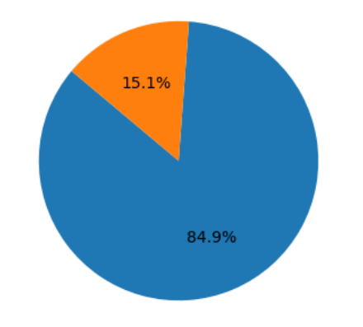
Exploratory Data Analysis
Distribution of TenYearCHD (Target Column)
Coronary Heart Disease (CHD) is a progressive condition where plaque buildup narrows coronary arteries, reducing blood flow to the heart. Predicting a patient's ten-year risk of CHD becomes a crucial window of opportunity for preventive measures.
Looking at the distribution, it appears the data shows a ratio of 15% to 85% for "yes" and "no" responses, respectively.

Slide 8
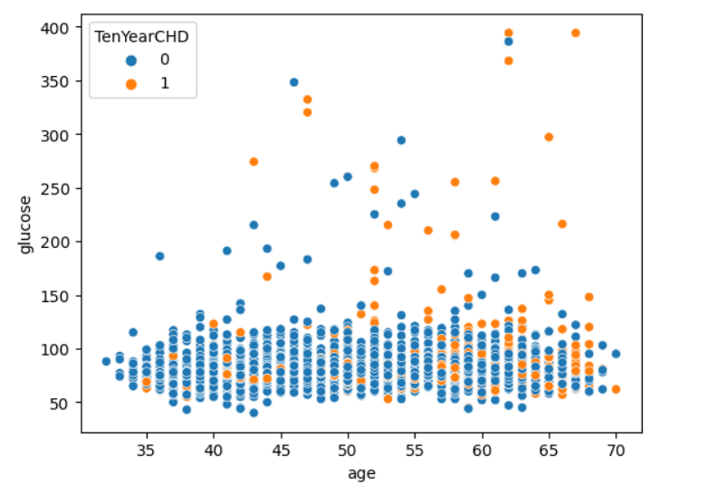
Exploratory Data Analysis
Observations:
There is a positive correlation between age and glucose levels. This means that as age increases, glucose levels also tend to increase.
The data points are spread out, indicating a varied range of glucose levels for each age group.
Some younger individuals have high glucose levels, while some older individuals have lower glucose levels. This suggests that factors other than age may also influence glucose levels.

Slide 9
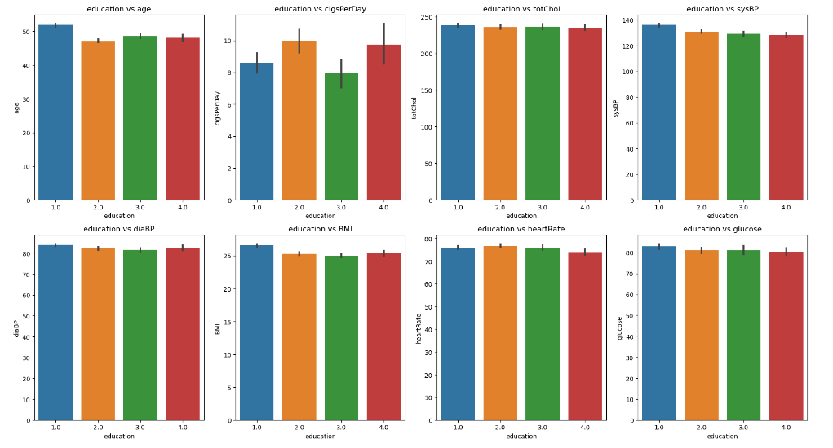
Exploratory Data Analysis
Blood Pressure : People with higher levels of education tend to have lower systolic and diastolic blood pressure.
Body Mass Index (BMI): There seems to be a weak inverse relationship between education and BMI. People with higher levels of education tend to have a lower BMI.
Heart Rate: The data for heart rate is inconclusive. There seems to be no clear association between education and heartrate.
Smoking: There seems to be an inverse relationship between education and the number of cigarettes smoked per day. People with higher levels of education tend to smoke less.
Cholesterol: There seems to be a weak inverse relationship between education and total cholesterol. People with higher levels of education tend to have lower cholesterol.

Slide 10
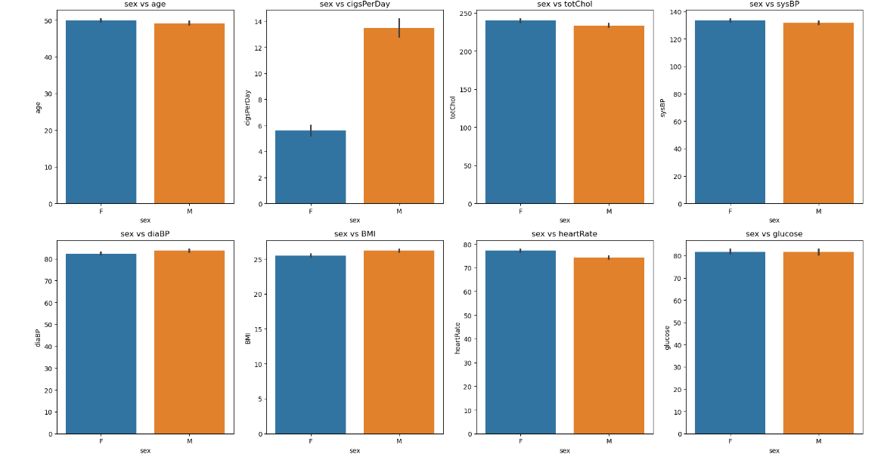
Exploratory Data Analysis
Men tend to be older.
Men smoke more cigarettes per day.
Men have higher total cholesterol, systolic and diastolic blood pressure, and BMI.
Women tend to have higher heart rates and blood glucose levels.

Slide 11
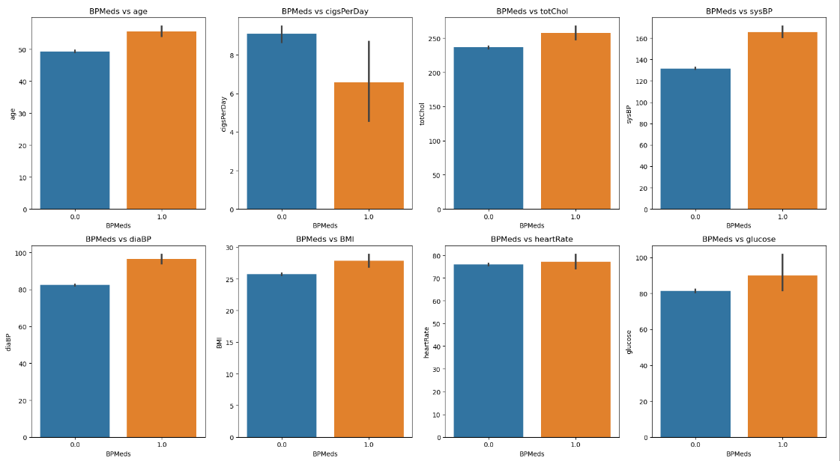
Exploratory Data Analysis
No clear association between BP meds and age, BMI, heart rate, or blood sugar. On the other hand, the data suggests that people who use blood pressure medication tend to have lower systolic and diastolic blood pressure. This is likely because blood pressure medication is designed to lower blood pressure. Additionally, people who use blood pressure medication tend to smoke fewer cigarettes per day, this could be because smoking can raise blood pressure.

Slide 12
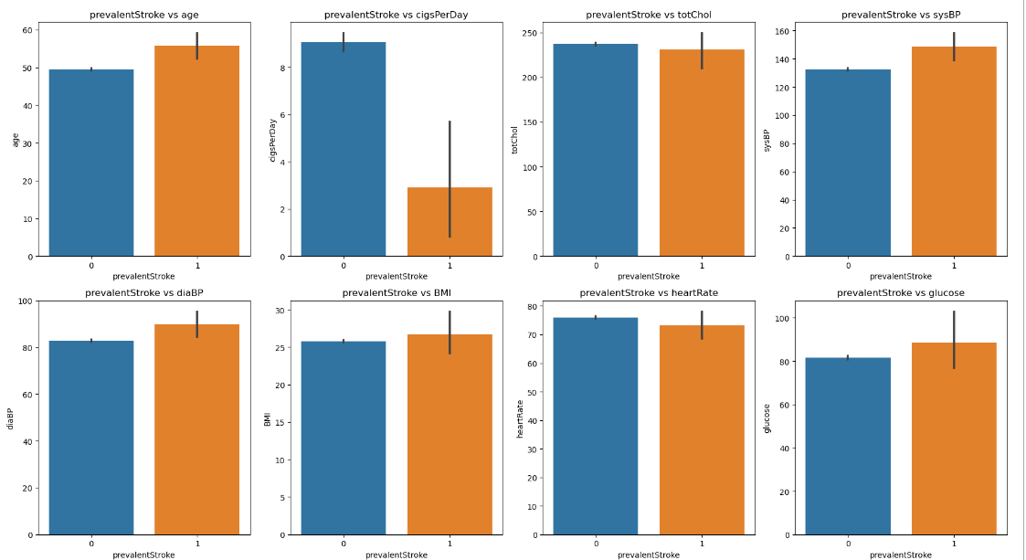
Exploratory Data Analysis
Age, cigarettes per day, systolic blood pressure, and diastolic blood pressure all show a positive correlation with prevalent stroke. This means that as these factors increase, the number of prevalent stroke cases also increases. These factors are all known risk factors for stroke.
The data for total cholesterol, BMI, heart rate, and blood glucose is inconclusive. There isn't a clear trend between these factors and prevalent stroke cases

Slide 13
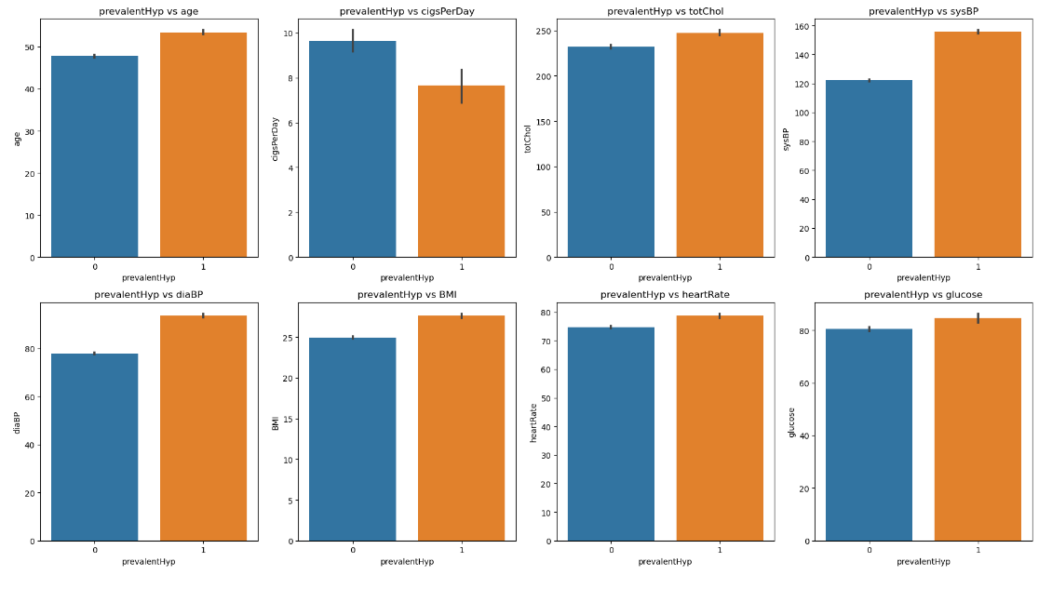
Exploratory Data Analysis
Age: The prevalence of hypertension increases with age. This is likely due to a number of factors, including the degeneration of the arteries and kidneys over time, as well as changes in hormone levels.
Cigarettes per day: Smoking is a major risk factor for hypertension. Smoking damages the blood vessels and makes them more narrow, which can increase blood pressure.
Systolic blood pressure (SysBP): This is the top number in a blood pressure reading. It represents the pressure against the artery walls when the heart beats. The higher the systolic blood pressure, the greater the risk of hypertension.
Diastolic blood pressure (DiaBP): This is the bottom number in a blood pressure reading. It represents the pressure against the artery walls when the heart is at rest. The higher the diastolic blood pressure, the greater the risk of hypertension.

Slide 14
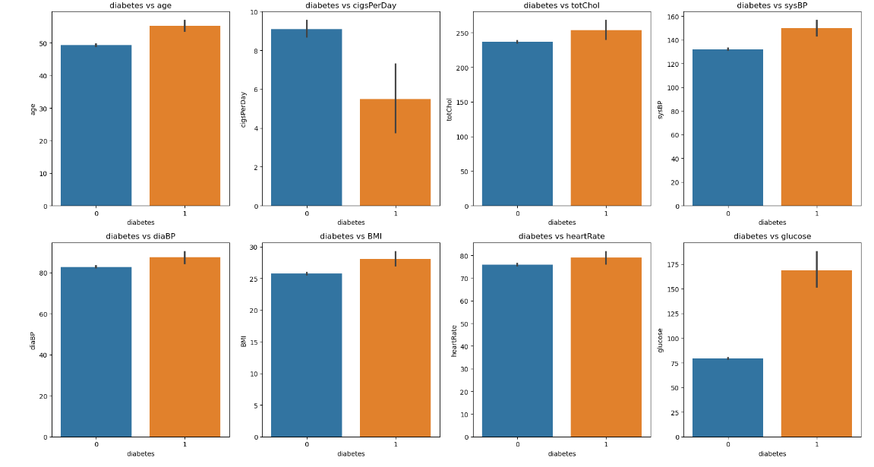
Exploratory Data Analysis
Body Mass Index (BMI): People with diabetes tend to have a higher BMI than those who do not have diabetes. BMI is a measure of a person's weight relative to their height. Having overweight or obesity can increase your risk of type 2 diabetes.
Smoking: Smoking is a major risk factor for many health problems, including heart disease, stroke, and lung cancer. It may also increase your risk of type 2 diabetes.
Cholesterol: High cholesterol is a risk factor for heart disease, and people with diabetes are also at increased risk of heart disease.

Slide 15
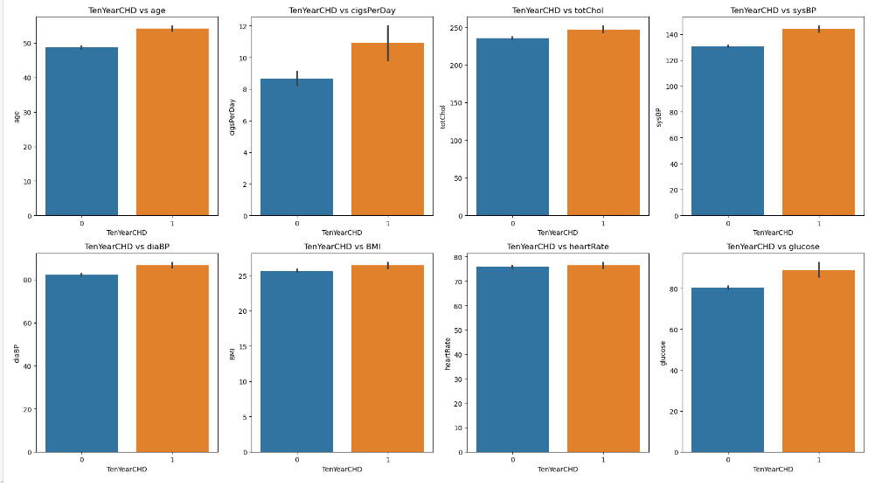
Exploratory Data Analysis
There is a weak positive correlation between age and diabetes. This means that as age increases, the likelihood of diabetes also increases. This is consistent with what we already know about diabetes.
People with diabetes tend to have a higher body mass index (BMI) than those who do not. This is likely because obesity is a major risk factor for type 2 diabetes.
The data for smoking, total cholesterol, systolic blood pressure (SysBP), diastolic blood pressure (DiaBP), heart rate, and blood sugar is inconclusive. There isn't a clear trend between these factors and diabetes in this dataset.

Slide 16
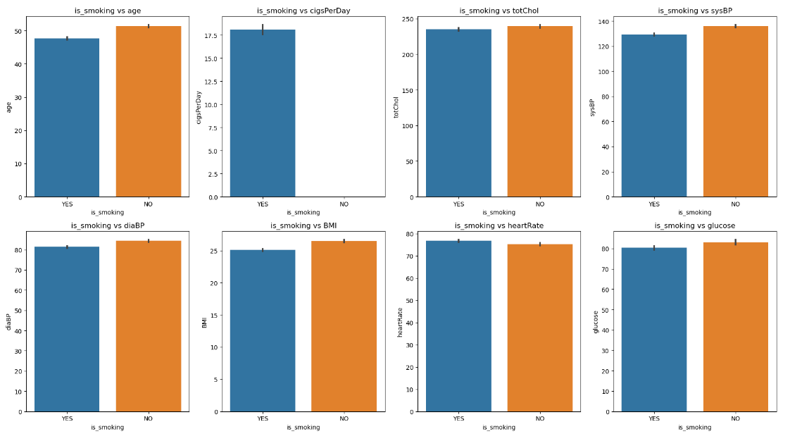
Exploratory Data Analysis
While research has definitively shown that smokers tend to be older and have higher cholesterol levels compared to non-smokers, the impact of smoking on other health markers remains unclear. Data on blood pressure, Body Mass Index (BMI), heart rate, and blood glucose levels haven't yielded conclusive evidence of a direct link to smoking. This suggests that other factors may play a more significant role in influencing these health measures for smokers and non-smokers alike. Further research is needed to understand the complex interplay between smoking and these other health indicators.

Slide 17
Machine Learning Approach
Introduction to Machine Learning Methodology for Predictive Modeling
In modern data-driven research and applications, machine learning (ML) methodologies play a pivotal role in extracting insights, making predictions, and solving complex problems across diverse domains. A well-defined ML approach encompasses several key stages, each tailored to address specific aspects of the data analysis and modeling process.
01
02
03
The first step in any ML methodology involves data preprocessing, where raw data is transformed, cleaned, and prepared for analysis. This stage typically includes tasks such as data cleaning to handle missing values and outliers, feature engineering to extract relevant information, and data normalization or scaling to ensure uniformity across features
Feature selection aims to identify and retain the most relevant features that contribute to the predictive power of the model while eliminating redundant or irrelevant features. Techniques such as univariate feature selection, recursive feature elimination, and feature importance ranking based on tree-based models are commonly employed in this stage.
Model selection involves choosing an appropriate ML algorithm or ensemble of algorithms based on the nature of the problem, the size and complexity of the dataset, and performance requirements. Common ML algorithms include linear regression, decision trees, support vector machines, random forests, and neural networks. Models are trained using labeled data.
04
05
06
Hyperparameter tuning involves optimizing the parameters of the selected ML algorithm(s) to improve model performance. Techniques such as grid search, random search, and Bayesian optimization are utilized to systematically explore the hyperparameter space and identify the optimal configuration that maximizes model performance metrics.
Model evaluation is a critical step in assessing the performance and generalization capabilities of the trained models. Various evaluation metrics such as accuracy, precision, recall, F1-score, and area under the receiver operating characteristic curve (AUC-ROC) are used to quantify model performance on unseen data through techniques such as cross-validation or holdout validation.
Once a satisfactory model is identified, it is deployed into production environments where it can make predictions on new, unseen data. Continuous monitoring of model performance and feedback loops for model refinement are essential to ensure that the deployed model remains accurate and reliable over time.

Slide 18
Machine Learning Approach
Deployment
Parameter Tuning
Training & Model Evaluation
Final
Feature Selection
Model Selection
Encoding
1.Logistic Regression
2.Decision Tree
3.Random Forest
4.Support Vector Machine
Exploratory Data Analysis
Data Cleaning
Descriptive Analysis
RAW Dataset

Slide 19
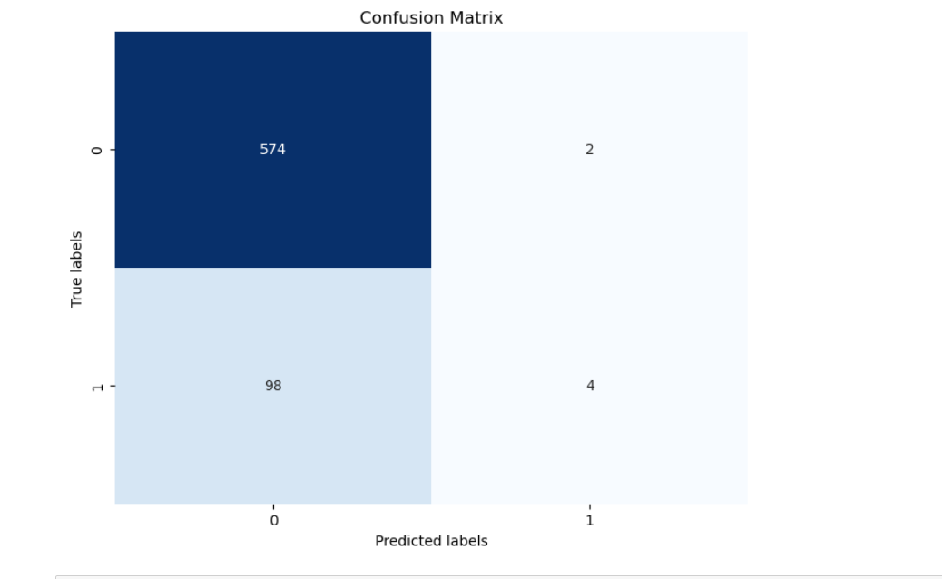
Model Evaluation
Logistic Regression
Logistic regression is a fundamental statistical technique used for binary classification tasks, where the outcome variable takes on one of two possible values. Unlike linear regression, which predicts continuous outcomes, logistic regression models the probability of the binary outcome using a logistic function. This logistic function maps the input features linearly onto the log odds of the outcome, constraining the predicted probabilities to fall between 0 and 1. One of the key strengths of logistic regression lies in its interpretability, as it allows for the estimation of the effect of each predictor variable on the probability of the outcome. Additionally, logistic regression is relatively simple and computationally efficient, making it well-suited for scenarios with a moderate number of predictors and a large number of observations. Despite its simplicity, logistic regression can be powerful when applied appropriately, providing valuable insights into the relationship between predictors and binary outcomes in various fields such as healthcare, finance, and social sciences.
Training Accuracy Score 0.8558259587020649
Test Accuracy Score 0.8525073746312685

Slide 20
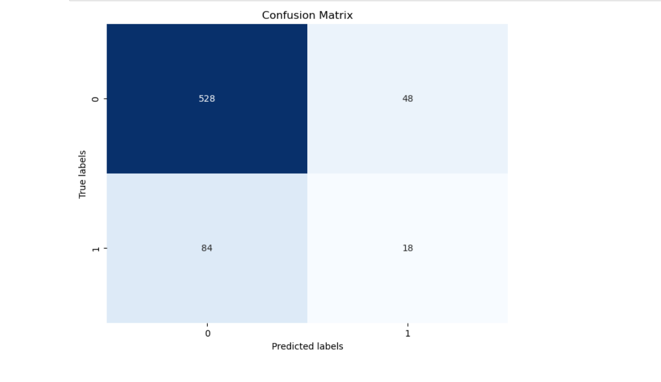
Model Evaluation
Decision Tree
A decision tree is a versatile and intuitive machine learning algorithm used for both classification and regression tasks. It operates by recursively partitioning the input space into smaller regions based on the features that best separate the data. At each node of the tree, a decision is made based on a feature's value, effectively splitting the dataset into subsets that are more homogeneous with respect to the target variable. This process continues until a stopping criterion is met, such as reaching a maximum tree depth or when further splits fail to improve the model's performance. Decision trees are highly interpretable, as they represent a sequence of simple if-else decision rules. Additionally, they can handle both numerical and categorical data, making them suitable for a wide range of applications. However, decision trees are prone to overfitting, especially when they are deep or when the dataset is noisy. To mitigate this issue, techniques like pruning and ensemble methods such as Random Forests are often employed. Overall, decision trees are valuable tools in the machine learning toolkit due to their simplicity, interpretability, and effectiveness in capturing complex relationships within the data.
Test Accuracy after Hyperparameter Tuning: 0.8053097345132744
Train Accuracy after Hyperparameter Tuning: 0.9122418879056047

Slide 21
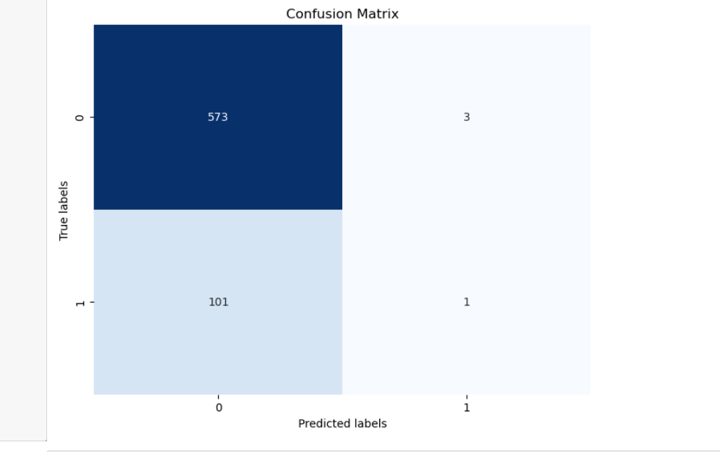
Model Evaluation
Random Forest
Random Forest is a powerful and versatile machine learning algorithm widely used for both classification and regression tasks. It operates by constructing a multitude of decision trees during the training phase and outputs the mode of the classes (classification) or the mean prediction (regression) of the individual trees. The strength of Random Forest lies in its ability to mitigate overfitting, handle high-dimensional data, and deal with noisy and correlated features. By aggregating the predictions from multiple trees, Random Forest tends to generalize well to unseen data, making it robust and reliable for a wide range of applications. Additionally, Random Forest provides built-in feature importance scores, allowing practitioners to gain insights into the relative significance of different features in the dataset. Its simplicity, scalability, and excellent performance make Random Forest a popular choice among data scientists and researchers for tackling various real-world problems in fields such as finance, healthcare, and environmental science.
Test Accuracy after Hyperparameter Tuning: 0.8466076696165191
Train Accuracy after Hyperparameter Tuning: 0.8757374631268436

Slide 22
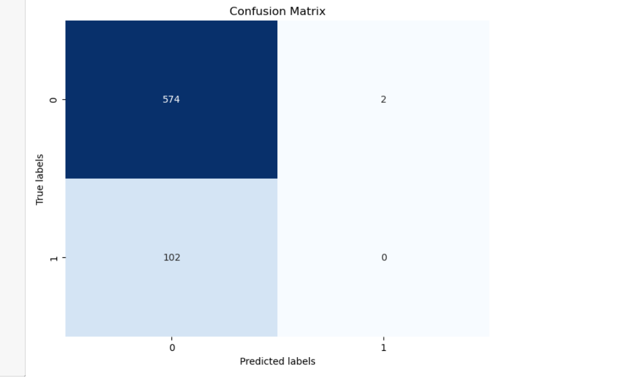
Model Evaluation
Support Vector Machines
Support Vector Machine (SVM) is a powerful and versatile supervised learning algorithm commonly used for classification and regression tasks. Its fundamental principle revolves around finding the optimal hyperplane that best separates classes in a high-dimensional feature space. SVM aims to maximize the margin, i.e., the distance between the hyperplane and the nearest data points (support vectors), thereby enhancing the model's robustness and generalization ability. One of the key strengths of SVM lies in its ability to handle both linear and non-linear classification problems through the use of different kernel functions, such as linear, polynomial, radial basis function (RBF), and sigmoid kernels. SVM is particularly well-suited for datasets with complex decision boundaries and is known for its effectiveness in handling high-dimensional data. Moreover, SVM exhibits resilience to overfitting, thanks to its regularization parameter, which helps control the trade-off between maximizing the margin and minimizing classification errors. Overall, SVM stands as a versatile and efficient algorithm that continues to find applications across various domains, including image classification, text categorization, bioinformatics, and financial forecasting.
Training Accuracy: 0.8595132743362832
Test Accuracy: 0.8466076696165191

Slide 23
Conclusion
Key Findings and Outcomes:
* This study has confirmed a clear association between smoking and two key health markers: age and cholesterol. Smokers tend to be older and have higher cholesterol levels compared to non-smokers.
* The impact of smoking on other health indicators, including blood pressure, BMI, heart rate, and blood glucose, remains inconclusive based on the data analyzed.
Future Work Potential:
* Further investigation is needed to explore the inconclusive relationships between smoking and blood pressure, BMI, heart rate, and blood glucose. This could involve:
* Analyzing a larger and more diverse sample population.
* Accounting for potential confounding factors like diet, physical activity, and socioeconomic status.
* Conducting longitudinal studies to track changes in health markers over time in relation to smoking habits.
* Research could also delve deeper into the mechanisms by which smoking might affect specific health outcomes.
* The findings on age and cholesterol can be used to develop targeted public health interventions aimed at encouraging smoking cessation, particularly among older adults.
By continuing this research, we can gain a more comprehensive understanding of the full spectrum of health consequences associated with smoking and develop more effective strategies to promote healthy lifestyles

Slide 24
THANKYOU

